Slide 1
UPPER SIXTH ARTS
GEOGRAPHY
Lesson 5
Types of Agricultural Systems
Notes:
Good morning, class, and welcome to our geography lesson. I am your geography teacher, Mr Kamdem. Today we are starting Lesson 5: Types of Agricultural Systems.

Slide 2
CLASS INFO
Class, Chapter and Duration
Class | Upper Sixth Arts
Chapter | Module 6: Understanding and managing the dynamics of economic activities across the world in general and Cameroon in particular
Duration | 2 periods (2 × 50 minutes)
Notes:
This lesson is for Upper Sixth Arts. It belongs to Module 6: Understanding and managing the dynamics of economic activities across the world in general and Cameroon in particular. We shall need 2 periods to cover it.

Slide 3
IDENTIFICATION
Lesson Identification
Topic | Agricultural Systems
Sub-topic | The Agricultural Systems
Lesson | Lesson 5: Types of Agricultural Systems
Notions / Concepts | Intensive subsistence, intensive commercial, extensive subsistence, extensive commercial, shifting cultivation, nomadic herding, ranching.
Syllabus focus | Intensive subsistence and commercial; extensive subsistence and commercial: arable and pastoral forms, characteristics, distribution, problems and solutions, with world examples.
Competence | Learners are able to describe and compare the four main agricultural systems.
Notes:
Our topic is Agricultural Systems, and the sub-topic is The Agricultural Systems. The key notions we shall use today are: intensive subsistence, intensive commercial, extensive subsistence, extensive commercial, shifting cultivation, nomadic herding, ranching. At the end, you should be able to do this: learners are able to describe and compare the four main agricultural systems.

Slide 4

HOMEWORK CORRECTION
Correction of the Homework
Question (Lesson 4: Agriculture as a System and its Classification):
Draw your family farm (or a farm you know) as a system.
Notes:
Before we start the new lesson, let us correct the homework I gave you at the end of Lesson 4: Agriculture as a System and its Classification. The question was: Draw your family farm (or a farm you know) as a system. Take out your exercise books.

Slide 5
HOMEWORK CORRECTION
Correction: Possible Answer
Family farm system: inputs – land, rain, family labour, seeds, hoes and manure; processes – clearing, sowing, weeding, harvesting; outputs – maize, groundnuts, income; feedback – money used to buy fertiliser.
Notes:
Here is a good answer. Family farm system: inputs – land, rain, family labour, seeds, hoes and manure; processes – clearing, sowing, weeding, harvesting; outputs – maize, groundnuts, income; feedback – money used to buy fertiliser. Compare it with your own answer and correct your work in red.

Slide 6
LESSON PLAN
Lesson Plan
Correction of the homework
Objectives and recall
Real-life situation and action to take
Learning activities
Board summary
Evaluation, remediation and homework
Notes:
Here is the plan of our lesson today. First, we shall correct the homework. Then we shall look at the objectives and recall what you already know. After that, we shall study a situation from real life and the action to take, and do the learning activities. Finally, we shall copy the board summary, do the evaluation and the remediation, and I will give you the homework.

Slide 7
OBJECTIVES
Objectives
By the end of this lesson, you should be able to:
Describe intensive subsistence and intensive commercial farming.
Describe extensive subsistence and extensive commercial farming.
Notes:
Take your time to copy this part; we will continue together.

Slide 8
OBJECTIVES
Objectives (continued)
Explain their problems and solutions.
Notes:
By the end of this lesson, you should be able to do three things. Number 1: describe intensive subsistence and intensive commercial farming. Number 2: describe extensive subsistence and extensive commercial farming. Number 3: explain their problems and solutions.

Slide 9
PREVIOUS KNOWLEDGE
Previous Knowledge
Farms can be intensive or extensive.
Farms can be subsistence or commercial.
Notes:
Let us first remember what you already know. Farms can be intensive or extensive. Farms can be subsistence or commercial. Keep this in mind, because we shall build on it today.

Slide 10
REAL-LIFE SITUATION
Situation in Real Life
A rice farmer in Asia works a tiny plot with her whole family. A rancher in Argentina keeps thousands of cattle on huge pastures with a few workers. Both are farmers, but their systems are very different.
Notes:
Listen carefully to this situation from real life. A rice farmer in Asia works a tiny plot with her whole family. A rancher in Argentina keeps thousands of cattle on huge pastures with a few workers. Both are farmers, but their systems are very different. Think about it, because I am going to ask you some questions.

Slide 11
REAL-LIFE SITUATION
Situation: Question 1
What is the problem in the situation?
Notes:
Question 1: What is the problem in the situation? Think for a moment, then raise your hand to answer.

Slide 12
REAL-LIFE SITUATION
Answer
Farming systems differ greatly.
Notes:
Good. Farming systems differ greatly.

Slide 13
REAL-LIFE SITUATION
Situation: Question 2
What type is the Asian rice farm?
Notes:
Question 2: What type is the Asian rice farm? Think for a moment, then raise your hand to answer.

Slide 14
REAL-LIFE SITUATION
Answer
Intensive subsistence.
Notes:
Good. Intensive subsistence.

Slide 15
REAL-LIFE SITUATION
Situation: Question 3
What type is the Argentine ranch?
Notes:
Question 3: What type is the Argentine ranch? Think for a moment, then raise your hand to answer.

Slide 16
REAL-LIFE SITUATION
Possible Answer
Extensive commercial.
Notes:
Good. Extensive commercial.

Slide 17
ACTION TO TAKE
Action to Take
Choose appropriate farming systems for each environment.
Notes:
From this situation, the action we are working towards in this lesson is the following: choose appropriate farming systems for each environment.

Slide 18
JUSTIFICATION
Justification of the Lesson
This lesson helps us to compare the great farming systems of the world.
Notes:
Why is this lesson important for you? This lesson helps us to compare the great farming systems of the world.

Slide 19
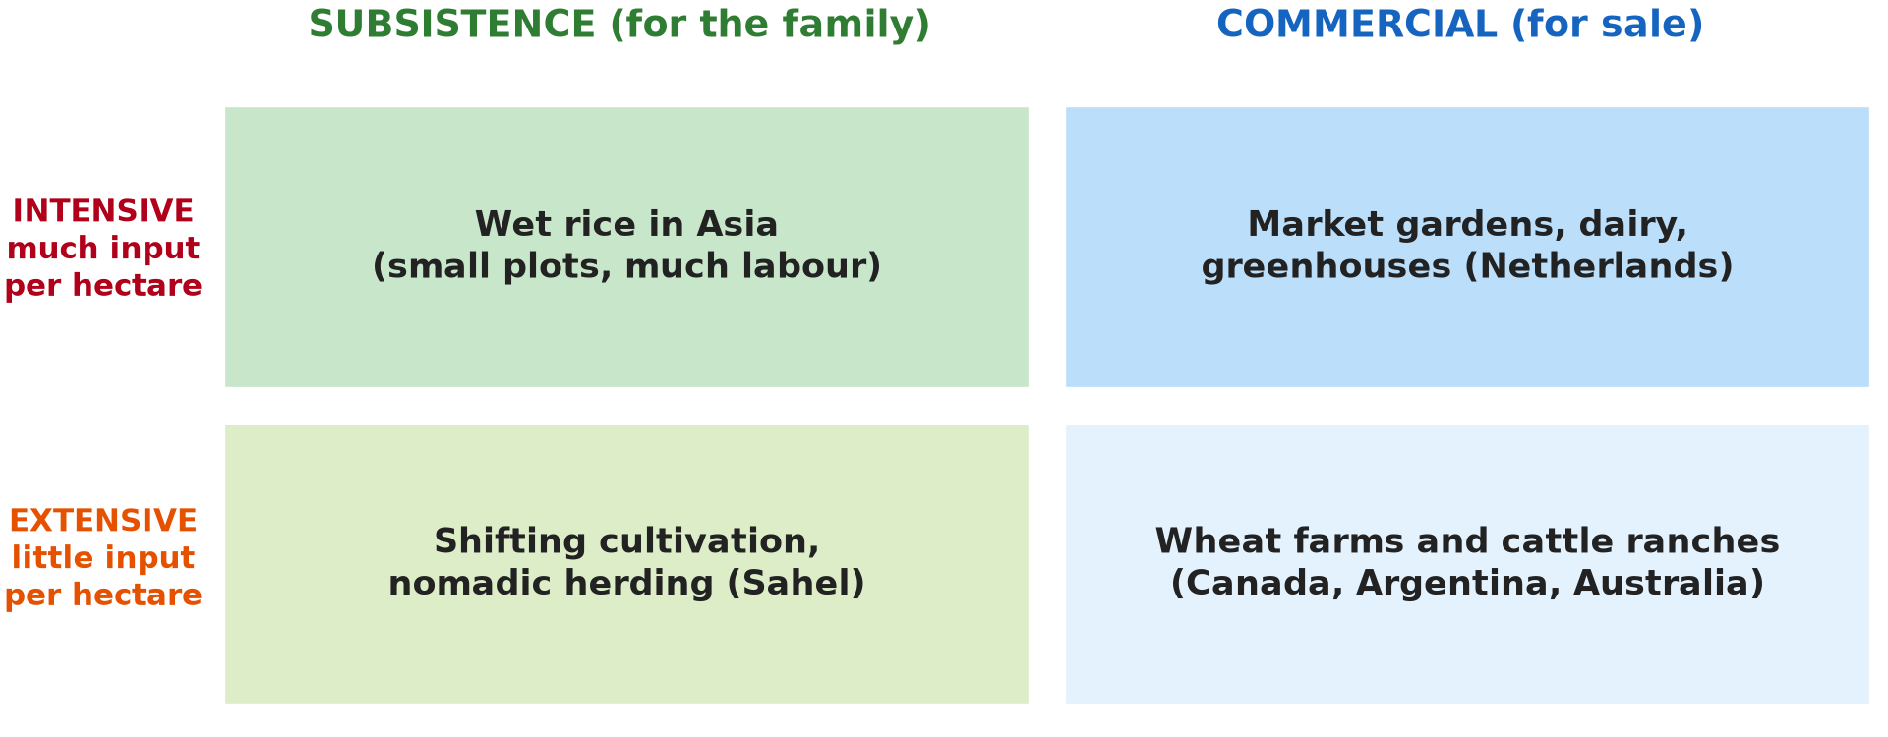
1. THE FOUR TYPES
Activity 1
The four agricultural systems.
Notes:
Activity 1. Look carefully at this diagram: the four agricultural systems. Observe every detail before I ask the question.

Slide 20
1. THE FOUR TYPES
Activity 1: Question
Give one example of each type.
Notes:
Here is the question for Activity 1: Give one example of each type. Take one minute to think and write your answer in your rough notebook.

Slide 21
1. THE FOUR TYPES
Activity 1: Answer
Wet rice; market gardening; shifting cultivation; wheat or ranching.
Notes:
Let us check the answer together. Wet rice; market gardening; shifting cultivation; wheat or ranching.

Slide 22
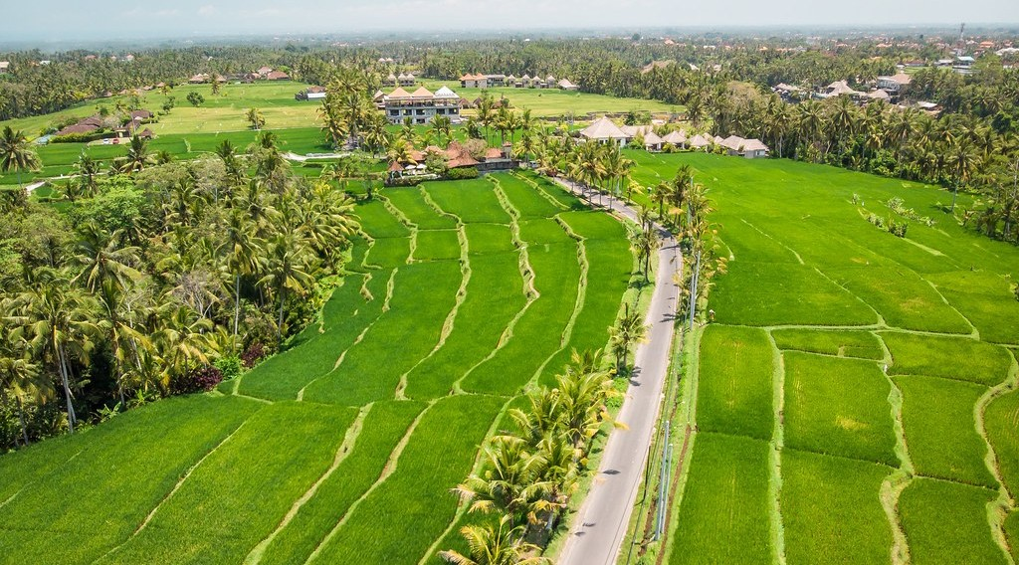
2. INTENSIVE SUBSISTENCE
Activity 2
Rice farming in Asia.
Notes:
Activity 2. Look carefully at this picture: rice farming in Asia. Observe every detail before I ask the question.

Slide 23
2. INTENSIVE SUBSISTENCE
Activity 2: Question
Why is wet rice farming intensive?
Notes:
Here is the question for Activity 2: Why is wet rice farming intensive? Take one minute to think and write your answer in your rough notebook.

Slide 24
2. INTENSIVE SUBSISTENCE
Activity 2: Answer
Much labour is used on small plots to get high yields.
Notes:
Let us check the answer together. Much labour is used on small plots to get high yields.

Slide 25
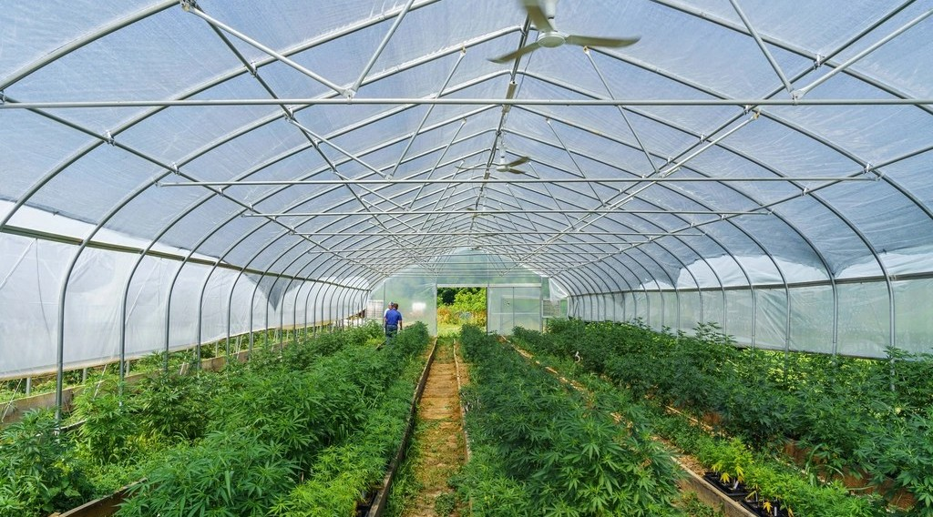
3. INTENSIVE COMMERCIAL
Activity 3
Vegetables grown in a greenhouse.
Notes:
Activity 3. Look carefully at this picture: vegetables grown in a greenhouse. Observe every detail before I ask the question.

Slide 26
3. INTENSIVE COMMERCIAL
Activity 3: Question
Why are greenhouses intensive commercial farming?
Notes:
Here is the question for Activity 3: Why are greenhouses intensive commercial farming? Take one minute to think and write your answer in your rough notebook.

Slide 27
3. INTENSIVE COMMERCIAL
Activity 3: Answer
Much capital is used on small areas to grow crops for sale.
Notes:
Let us check the answer together. Much capital is used on small areas to grow crops for sale.

Slide 28

4. EXTENSIVE SUBSISTENCE
Activity 4
Herders with cattle in the Sahel.
Notes:
Activity 4. Look carefully at this picture: herders with cattle in the Sahel. Observe every detail before I ask the question.

Slide 29
4. EXTENSIVE SUBSISTENCE
Activity 4: Question
Why is nomadic herding extensive?
Notes:
Here is the question for Activity 4: Why is nomadic herding extensive? Take one minute to think and write your answer in your rough notebook.

Slide 30
4. EXTENSIVE SUBSISTENCE
Activity 4: Answer
Large areas are used with little input per hectare.
Notes:
Let us check the answer together. Large areas are used with little input per hectare.

Slide 31

5. EXTENSIVE COMMERCIAL
Activity 5
A combine harvester on a large farm.
Notes:
Activity 5. Look carefully at this picture: a combine harvester on a large farm. Observe every detail before I ask the question.

Slide 32
5. EXTENSIVE COMMERCIAL
Activity 5: Question
Give two characteristics of extensive commercial grain farming.
Notes:
Here is the question for Activity 5: Give two characteristics of extensive commercial grain farming. Take one minute to think and write your answer in your rough notebook.

Slide 33
5. EXTENSIVE COMMERCIAL
Activity 5: Answer
Huge farms, many machines, few workers, low yield per hectare.
Notes:
Let us check the answer together. Huge farms, many machines, few workers, low yield per hectare.

Slide 34
BOARD SUMMARY
Board Summary
Topic: Agricultural Systems
Sub-topic: The Agricultural Systems
Lesson 5: Types of Agricultural Systems
Notes:
Now we are going to copy the board summary. Write the title and the headings neatly in your notebooks. I will give you enough time for each slide, so do not rush.

Slide 35
BOARD SUMMARY
DEFINITIONS
The key terms of this lesson are defined as follows:
Intensive farming: It is farming with high inputs of labour or capital on a small area to obtain high yields per hectare.
Extensive farming: It is farming with low inputs per hectare on large areas.
Notes:
Let us copy the definitions. The key terms of this lesson are defined as follows. On this slide we have Intensive farming and Extensive farming. Write each point on a new line, with the key term first, and explain it in your own words when we revise.

Slide 36
BOARD SUMMARY
1. Intensive Systems
Intensive farming systems include:
Intensive subsistence farming: Small plots, much family labour and high yields feed the family, as in wet rice farming in Monsoon Asia. Problems are small farms and poverty; solutions are irrigation and improved seeds.
Notes:
Let us copy Intensive Systems. Intensive farming systems include. On this slide we have Intensive subsistence farming. Write each point on a new line, with the key term first, and explain it in your own words when we revise. When you finish, we go to the next slide.

Slide 37
BOARD SUMMARY
1. Intensive Systems (continued)
Intensive commercial farming: Much capital, machines and technology are used on small areas for the market, as in Dutch greenhouses, market gardens and dairy farms. Problems are high costs and pollution by chemicals.
Notes:
We continue with Intensive Systems. On this slide we have Intensive commercial farming. Write each point on a new line, with the key term first, and explain it in your own words when we revise.

Slide 38
BOARD SUMMARY
1. Intensive Systems
Illustration: the four agricultural systems
Notes:
Now draw this illustration in your notebook: the four agricultural systems. Give it a title and label it clearly.

Slide 39
BOARD SUMMARY
2. Extensive Systems
Extensive farming systems include:
Extensive subsistence farming: Shifting cultivation in forests and nomadic herding in the Sahel use large areas with little input. Problems are low yields and land degradation when population grows.
Notes:
Let us copy Extensive Systems. Extensive farming systems include. On this slide we have Extensive subsistence farming. Write each point on a new line, with the key term first, and explain it in your own words when we revise. When you finish, we go to the next slide.

Slide 40
BOARD SUMMARY
2. Extensive Systems (continued)
Extensive commercial farming: Huge farms with machines and few workers grow grain or rear cattle for export, as in the Canadian Prairies, Argentina and Australia. Problems are soil erosion and dependence on world prices.
Notes:
We continue with Extensive Systems. On this slide we have Extensive commercial farming. Write each point on a new line, with the key term first, and explain it in your own words when we revise. When you finish, we go to the next slide.

Slide 41
BOARD SUMMARY
2. Extensive Systems (continued)
Arable and pastoral examples: Each system can be arable (crops) or pastoral (animals). For example, ranching is extensive commercial pastoral farming, and nomadic herding is extensive subsistence pastoral farming.
Notes:
We continue with Extensive Systems. On this slide we have Arable and pastoral examples. Write each point on a new line, with the key term first, and explain it in your own words when we revise.

Slide 42
FORMATIVE EVALUATION
Evaluation 1
Compare intensive subsistence and extensive commercial farming.
Notes:
Now let us check what you have understood. Question 1: Compare intensive subsistence and extensive commercial farming. Answer in your exercise book.

Slide 43
FORMATIVE EVALUATION
Expected Answer
Intensive subsistence: small plots, much labour, for the family. Extensive commercial: huge farms, machines, for sale.
Notes:
The expected answer is: intensive subsistence: small plots, much labour, for the family. Extensive commercial: huge farms, machines, for sale. If you got it right, well done.

Slide 44
FORMATIVE EVALUATION
Evaluation 2
Give two problems of nomadic herding.
Notes:
Now let us check what you have understood. Question 2: Give two problems of nomadic herding. Answer in your exercise book.

Slide 45
FORMATIVE EVALUATION
Expected Answer
Overgrazing and drought (also conflicts with farmers).
Notes:
The expected answer is: overgrazing and drought (also conflicts with farmers). If you got it right, well done.

Slide 46
REMEDIATION
Remediation
Fill in the blanks:
Wet rice is ______ subsistence farming.
Cattle ranching is extensive ______ farming.
Clearing, farming and moving on is ______ cultivation.
Notes:
For those who need more practice, fill in the blanks in your exercise book. The answers are: number 1, intensive; number 2, commercial; number 3, shifting.

Slide 47
HOMEWORK
Homework
Classify three farming systems found in Cameroon.
Notes:
For your homework: Classify three farming systems found in Cameroon. We shall correct it at the beginning of our next lesson.

Slide 48
NEXT LESSON
Next Lesson
Our next lesson will be on:
Lesson 6: Von Thünen's Theory of Agricultural Land Use
Notes:
Our next lesson will be on Lesson 6: Von Thünen's Theory of Agricultural Land Use. Thank you for your attention, and see you next time.

Slide 49
BILINGUAL GAME
Bilingual Game (Jeu Bilingue)
English | Français
Intensive | Intensif
Extensive | Extensif
Shifting cultivation | La culture itinérante
Ranch | Le ranch
Greenhouse | La serre
Nomadic herding | L'élevage nomade
Notes:
Let us play the bilingual game. I say a word in English, and you give me the French word. Then we do the reverse.

Slide 50
LOGBOOK
Official Logbook (1/2)
Module / Topic | Agricultural Systems
Lesson Title | Lesson 5: Types of Agricultural Systems
Expected Learning Outcomes | Describe intensive subsistence and intensive commercial farming. Describe extensive subsistence and extensive commercial farming. Explain their problems and solutions.
Competence | Learners are able to describe and compare the four main agricultural systems.
Notes:
I record this information in the official logbook of the class after the lesson.

Slide 51
LOGBOOK
Official Logbook (2/2)
Matter Taught | DEFINITIONS; Intensive Systems; Extensive Systems.
Evaluation | Formative evaluation and remediation exercise.
Homework | Classify three farming systems found in Cameroon.
Enrolment / Present / Absent | ____ / ____ / ____
Achievement | To be completed after the lesson.
Notes:
I complete the second page of the logbook: the matter taught, the evaluation, the homework and the attendance.

Slide 52
TEACHER'S NOTE
Teacher's Note
Timing: Homework correction, plan, objectives 8 min | Recall, situation, action 10 min | 5 activities 30 min | Board summary (copying) 30 min | Evaluation, remediation 10 min | Homework, next lesson 5 min | Logbook 7 min
Without the projector (Activity 1): copy the grid.
Without the projector (Activity 2): find the monsoon lands.
Without the projector (Activity 3): discuss market gardens near towns.
Without the projector (Activity 4): describe transhumance.
Without the projector (Activity 5): find the Prairies.
Notes:
This slide is for me, the teacher: it gives the timing of the lesson and what to do if the projector is not available.

Slide 53
REFERENCES
References
National Geography Syllabus, MINESEC/IGE/IP-SS, 2019 — Module 6 (Economic Geography).
Photo, Activity 2: “Drone view of rice plantation on bali island with path to walk around ” by Artem Beliaikin, CC0 1.0, via Flickr (https://www.flickr.com/photos/157635012@N07/46229046541)
Photo, Activity 3: “Organic farming, vegetable patch” by U.S. Department of Agriculture, CC0 1.0, via rawpixel (https://www.rawpixel.com/image/10995692/organic-farming-vegetable-patch)
Photo, Activity 4: “Young cattle herders in Sénégal (West Africa)” by gbaku, CC BY-SA 2.0, via Flickr (https://www.flickr.com/photos/72105154@N00/525185172)
Photo, Activity 5: “John Deere Combine” by SnoShuu, CC BY-NC-ND 2.0, via Flickr (https://www.flickr.com/photos/85888233@N00/2776467094)
Diagrams and animations: drawn for this lesson (Geography Department).
Notes:
These are the references and picture credits used to prepare this lesson.

